Slide 1
IBM University Engagement Project Submission
“Exploring the Power of Agentic AI with IBM Granite and LangFlow”

Slide 2
Project Title – Smart Study Generator Agent
Domain of Project – Education
Faculty Name | Recent Passport Photo | Email ID | Mobile number [WhatsApp]
Prachi Shah |  | prachi.shah@bvmengineering.ac.in prachishah97@gmail.com | 9408400907

Slide 3
Problem Statement -
Problem Statement : Smart Study Generator Agent
The Challenge
Students today face an overwhelming flood of information—lecture notes, textbooks, research papers, YouTube tutorials, and online resources. This content is scattered, unorganized, and often not personalized to their learning pace or style. As a result, students struggle with finding the right study material, summarizing key concepts, and staying exam-ready. Traditional study tools only provide static notes or flashcards, failing to adapt dynamically to student needs. The challenge is to move beyond static resources toward an intelligent, adaptive study companion.

Slide 4
Problem Statement -
The Objective
Build an agentic AI-powered Smart Study Generator that personalizes and streamlines learning for students. The solution should:
1. Fuse Learning Resources: Aggregate content from class notes, textbooks, research articles, and online tutorials into structured, easy-to-digest study material.
2. Enable Multimodal Input: Allow students to upload notes, voice queries, or images (e.g., textbook pages), and generate concise summaries, flashcards, or concept maps.
3. Create a Predictive & Agentic Layer: Recommend personalized study plans, highlight important topics based on syllabus or past exams, and provide predictive alerts (e.g., “Focus on Topic X—frequently asked in exams”).
4. Visualize Study Progress: Offer a real-time dashboard showing learning milestones, weak areas, practice quizzes, and performance forecasts.

Slide 5
Technology Used
Tech Stack
I used LangFlow + IBM watsonx.ai + Granite Models

Slide 6
Proposed Solution -
The Smart Study Generator Agent is an Agentic AI-powered educational platform designed to transform a student's study topic into a complete personalized learning package. The solution leverages LangFlow's multi-agent orchestration capabilities, IBM Granite foundation models, and Retrieval-Augmented Generation (RAG) to provide intelligent, adaptive, and exam-oriented study support.
The system consists of four specialized AI agents that collaborate to create a seamless learning experience:
1. Study Analyst Agent
The Study Analyst Agent acts as the academic expert of the system. It analyzes the student's topic, identifies key concepts, determines difficulty levels, extracts important definitions and formulas, and creates a structured understanding of the subject.
2. Content Generator Agent
The Content Generator Agent converts the analyzed topic into learning materials such as detailed notes, flashcards, multiple-choice questions (MCQs), short-answer questions, revision sheets, and concept summaries.
3. Learning Coach Agent
The Learning Coach Agent provides personalized learning guidance by generating study schedules, revision plans, exam preparation strategies, and recommendations based on the student's available study time and exam timeline.
4. Agentic AI Planner
The Planner Agent orchestrates the workflow between all agents. It determines the sequence of execution, manages information flow between agents, and ensures that each agent contributes to the final personalized study package.
The system is further enhanced through RAG-based knowledge retrieval, allowing agents to access relevant educational content before generating responses. IBM Granite Models provide reasoning and content generation capabilities, while IBM Watsonx.ai ensures scalable deployment and AI governance.

Slide 7
Langflow component Used -
1) Chat Input Interface where students enter study topics, learning requirements, exam timelines, or academic queries.
2) IBM watsonx AI Agent Processes student inputs using IBM Granite models and coordinates the Study Analyst Agent, Content Generator Agent, and Learning Coach Agent to generate personalized learning resources and study recommendations.
3) IBM Granite Model – Granite-4-H-Small (or the Granite model used in your project) Provides natural language understanding, reasoning, topic analysis, content generation, and personalized study guidance in real time.
4) Chat Output Displays AI-generated outputs such as topic analysis, notes, flashcards, MCQs, revision sheets, study plans, and exam preparation recommendations.
5) File Component Stores and retrieves educational resources, generated study materials, learning history, and knowledge-base content for future reference and analysis.
6) Prompt Template Component Provides structured instructions to agents, ensuring consistent generation of study materials, topic analysis, and personalized learning recommendations.
7) Vector Store (FAISS/Chroma) Stores embeddings of educational content and enables semantic search for RAG-based knowledge retrieval.
8) Retriever Component Fetches relevant study content from the vector database to provide contextual and accurate responses.
9) RAG Pipeline Combines retrieved educational information with IBM Granite Models to generate context-aware, reliable, and personalized learning content.

Slide 8
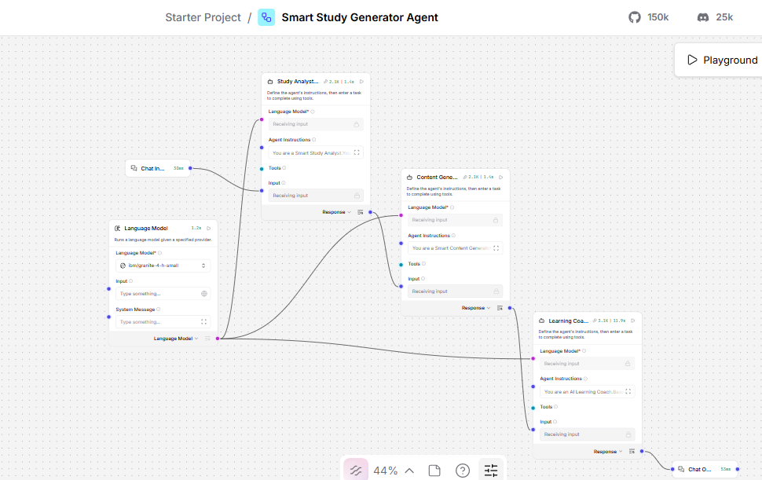
Langflow workflow -

Slide 9
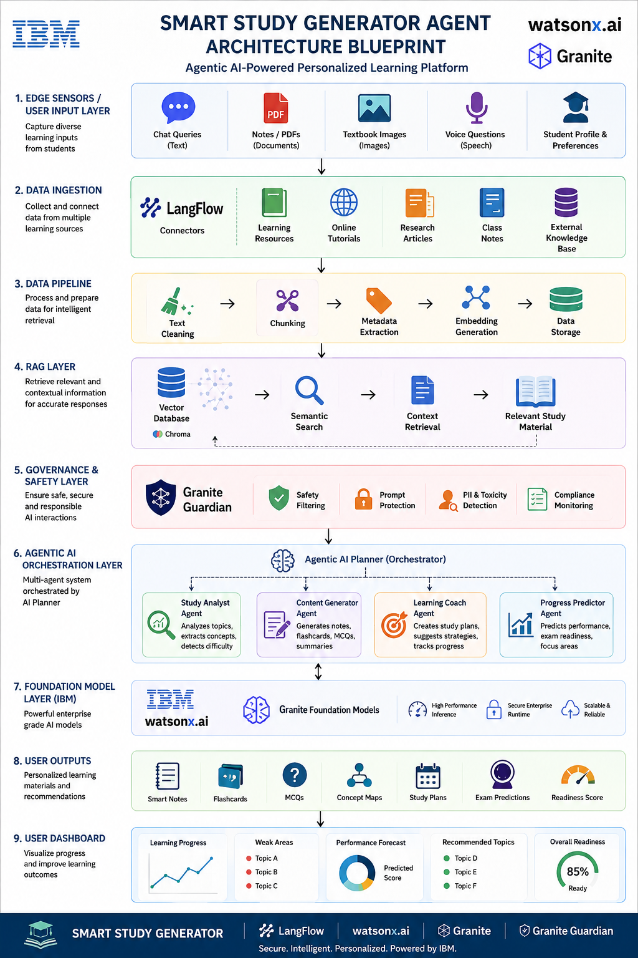
Architecture blueprint

Slide 10

Role of Agentic AI in the solution
Role of Agentic AI in Smart Study Generator
Agentic AI enables the Smart Study Generator to function as an intelligent, autonomous learning system rather than a simple educational chatbot. Using IBM watsonx.ai and IBM Granite Models, it coordinates multiple specialized agents to deliver personalized and exam-focused learning support.
Study Analyst Agent analyzes the student's topic, identifies key concepts, definitions, formulas, and determines the difficulty level.
Content Generator Agent creates structured learning resources such as notes, flashcards, MCQs, revision sheets, and concept summaries.
Learning Coach Agent develops personalized study plans, revision schedules, exam strategies, and recommends focus areas based on student needs.
Agentic AI Planner orchestrates communication between agents, manages workflow execution, and ensures seamless collaboration.
The agents work together and leverage RAG (Retrieval-Augmented Generation) to retrieve relevant educational information before generating responses, improving accuracy and contextual relevance.
Overall, Agentic AI makes the system proactive, personalized, and goal-driven, acting as a smart digital study companion that helps students learn efficiently, stay exam-ready, and achieve better academic outcomes.

Slide 11
Technology Used
LangFlow Platform
Used for designing and orchestrating the multi-agent workflow visually. It enables seamless coordination between the Study Analyst Agent, Content Generator Agent, Learning Coach Agent, and AI Planner Agent to automate the learning process.
IBM Granite Model (Granite-4-H-Small)
Provides natural language understanding, reasoning, content generation, and personalization. It analyzes study topics, generates notes, flashcards, MCQs, and delivers personalized study recommendations.
IBM Cloud
Provides the infrastructure to build, deploy, and scale the Smart Study Generator efficiently. IBM Cloud offers a secure, reliable, and scalable environment for hosting AI services and managing agent workflows.
Retrieval-Augmented Generation (RAG)
RAG retrieves relevant educational content from the knowledge base before generating responses. This improves accuracy, reduces hallucinations, and enables context-aware study material generation.
IBM watsonx.ai
Used for model deployment, inference, embeddings generation, and AI governance. It powers the IBM Granite Models and ensures responsible, secure, and scalable AI operations.
Vector Database (FAISS/Chroma)
Stores embeddings of educational resources and supports semantic search for RAG-based knowledge retrieval. It helps agents access relevant study content and generate more accurate learning recommendations.

Slide 12
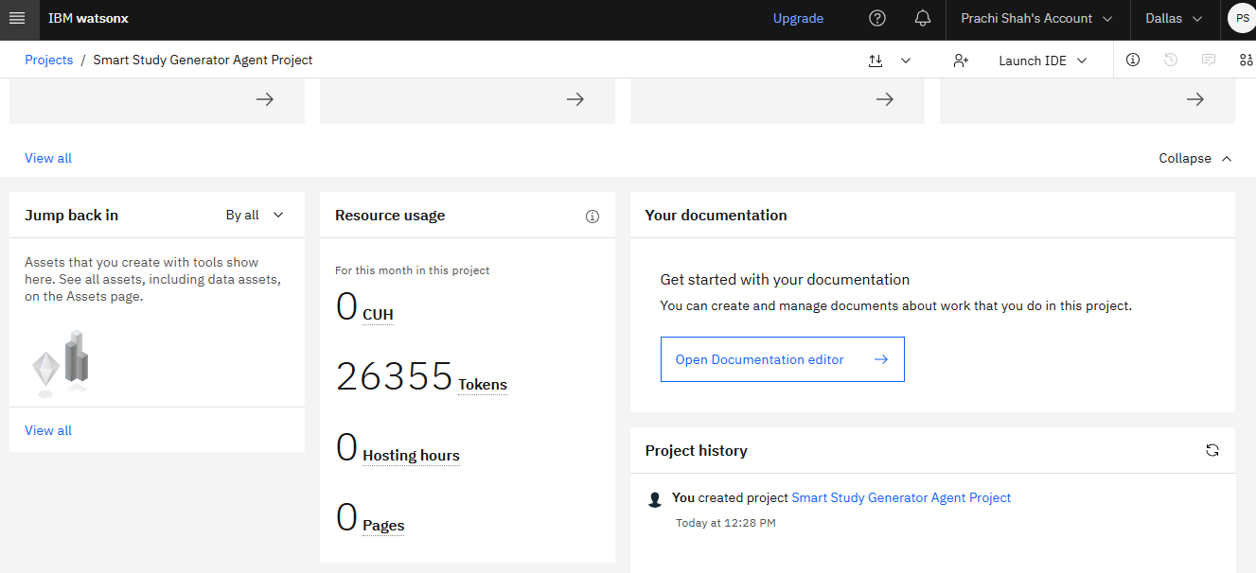
Token Usage
26,355 tokens are used
·
·
·

Slide 13
Novelty and Uniqueness
The proposed Smart Study Generator stands out by combining Agentic AI, RAG, and Personalized Learning into a single intelligent educational platform.
Multi-Agent Intelligence – Instead of relying on a single chatbot, multiple specialized agents (Study Analyst Agent, Content Generator Agent, Learning Coach Agent, and AI Planner Agent) collaborate to deliver accurate, structured, and context-aware learning support.
RAG-Based Accuracy – Integrates knowledge retrieval with AI generation, enabling the system to access relevant educational content before generating responses, thereby improving accuracy and reducing misinformation.
Hyper-Personalized Learning – Creates customized study plans, revision schedules, and learning recommendations based on the student's subject, difficulty level, study duration, weak areas, and exam timeline.
Adaptive Learning Guidance – Continuously refines study recommendations and focus areas based on student inputs, helping learners stay on track and improve performance.
Automated Study Material Generation – Instantly generates notes, flashcards, MCQs, revision sheets, and concept summaries from a single study topic, reducing manual effort for students.
Predictive Exam Preparation – Identifies high-priority topics, recommends focus areas, and provides exam-readiness insights to support effective preparation.
Scalable & Enterprise-Ready – Built on IBM watsonx.ai, IBM Granite Models, and IBM Cloud, ensuring reliability, security, governance, and scalability.
This makes the solution a smart, adaptive, and proactive digital study companion, rather than just a traditional educational chatbot or static study tool.

Slide 14
Git Hub Link
· Please create public github repository (Enable Add README button while creating repository) with format –
Please test and Paste the working Github URL – https://github.com/prachi9789/Smart-Study-Generator
Make sure you have Uploaded following three files into your github repository 1) app.json file, 2) yourproblemstatement.pdf file 3) your projectpresntation.pptx file 4)any other files
·
·
·

Slide 15
Future Scope
Multimodal Learning Support – Extend the platform to support voice queries, textbook image analysis, handwritten notes, and document uploads for a richer learning experience.
Real-Time Learning Analytics – Introduce interactive dashboards to track student progress, learning patterns, strengths, and weak areas in real time.
Adaptive Learning Paths – Dynamically adjust study plans and content difficulty based on student performance, learning pace, and assessment results.
AI Tutor & Doubt Resolution – Integrate an intelligent tutoring agent capable of answering subject-specific questions and providing step-by-step explanations.
Collaborative Learning Environment – Enable group study sessions, peer discussions, and AI-assisted collaborative learning activities.
Integration with Educational Platforms – Connect with Learning Management Systems (LMS) such as Moodle, Google Classroom, and university portals for seamless academic support.
Predictive Academic Insights – Use advanced analytics to predict exam performance, identify at-risk students, and recommend targeted interventions.
Mobile & Enterprise Deployment – Develop mobile applications and deploy the solution at institutional scale using IBM Cloud for wider accessibility and adoption.
Vision: Transform the Smart Study Generator into a comprehensive AI-powered learning ecosystem that acts as a personal tutor, study planner, and academic mentor for students.
·
·
·

Slide 16


